Slide 1


Guess That Character!

Slide 2

Guess That Character!
Yuno Gasai
Hi!

Slide 3
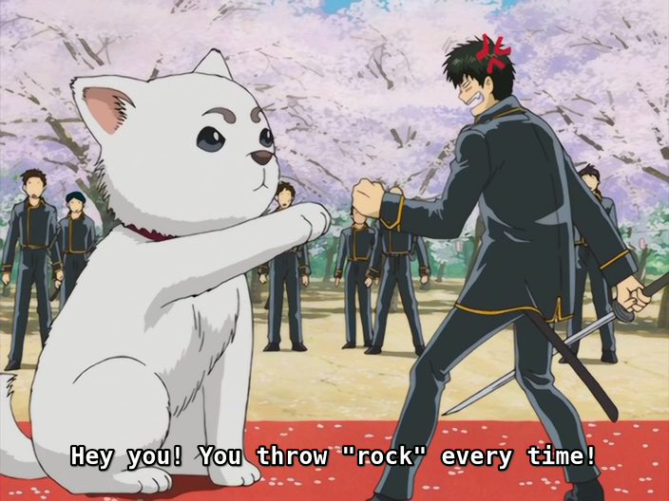
COMEDY

Slide 4
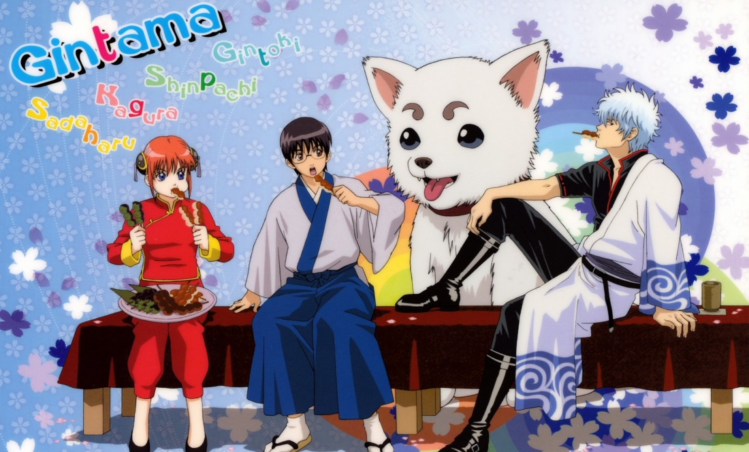



Some good comedy anime shows w/action

Slide 5




Some good pure comedy shows

Slide 6
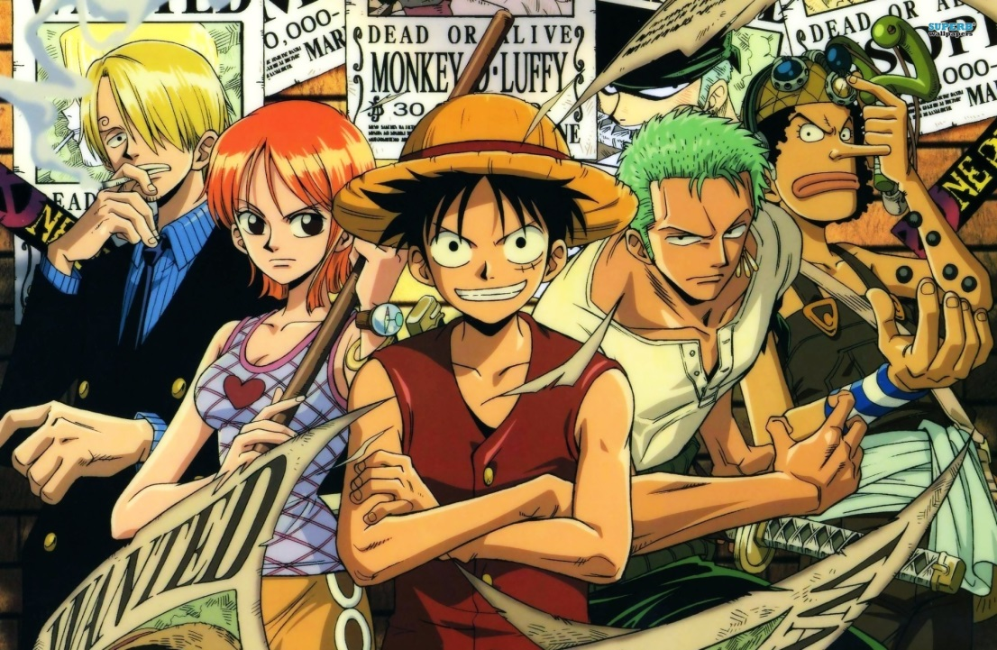



+ Some personal favorite comedy shows

Slide 7
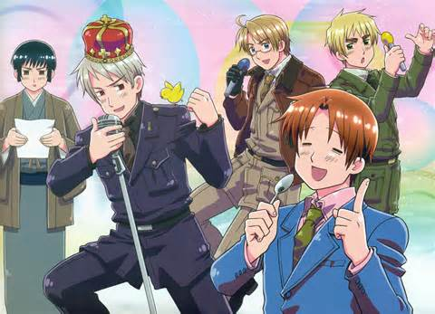
And, of course, HETALIA

