Slide 1





3
Who’s
That
Character?
Sailor Moon /
Usagi Tsukino

Slide 2

Shounen VS Shoujo
Shoujo
Vs
Shounen

Slide 3

Shoujo in Japanese means “girl”.
A series that is labeled as shoujo
means that the series is directed
towards 7 to 18 year old
female viewers.
Shounen in Japanese means
“boy”.
A series that is labeled as
shounen means that the
series is directed towards
7 to 18 year old male viewers.

Slide 4
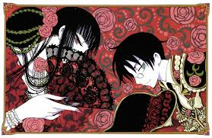
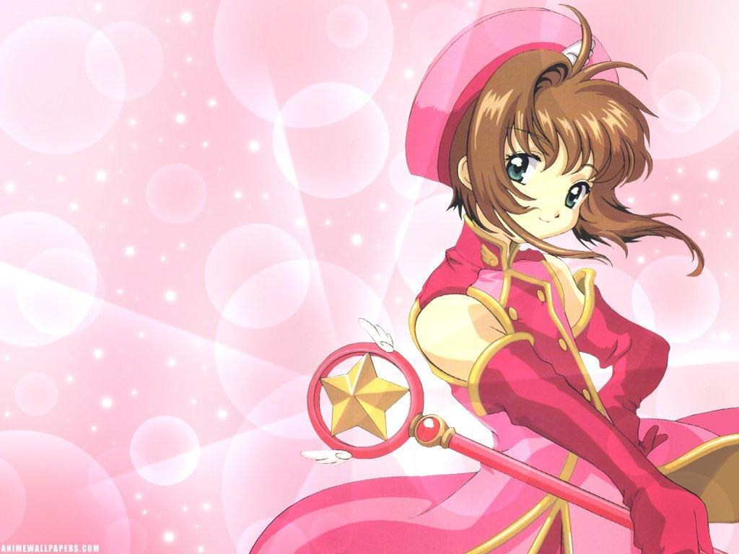
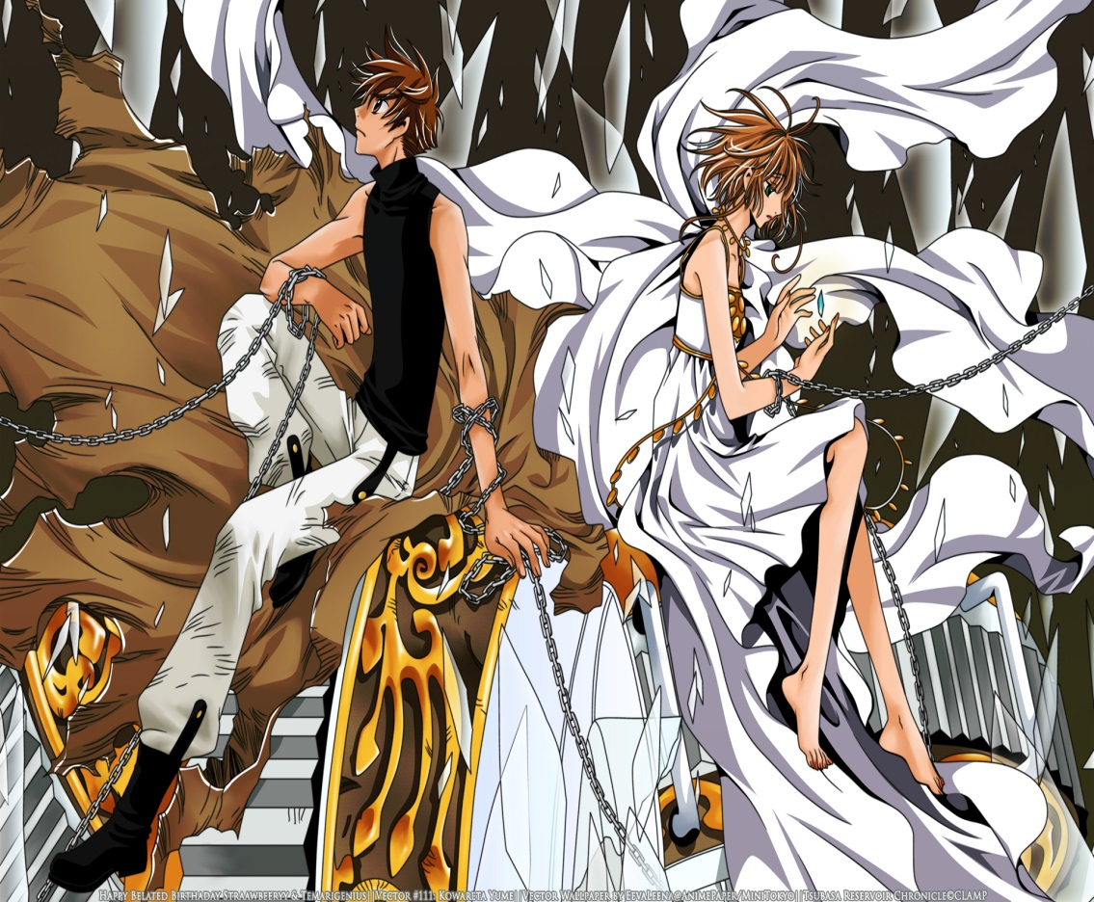
What shoujo animes can you name?
Notes:
Talk about CLAMP. CLAMP is a group of mangaka who have created countless fantasy mangas, many of which are shounen. The characters are re-used in nearly every one of their series, making a trademark for CLAMP.

Slide 5



What are some shounen animes?
Notes:
Talk about Hiro Mashima. Hiro Mashima is a mangaka with an interesting touch to his fantasy stories. To the left we have his most recent work “Fairy Tail”. Main character is Natsu, which translates as “Summer”. Next, his previous work “Rave Master”. Main character is “Haru”, which translates as “Spring”. His debut (right) manga “Soul Monster” hadn’t been made into an anime, but note that the main character’s name is “Aki”, which translates to “Autumn”. So Mashima has quite the love for naming his main characters after seasons. ^^ After this, watch the first anime episode of “Fairy Tail”, then watch the first episode of “CardCaptor Sakura”. Make some comparisons and contrasts.

