Slide 1



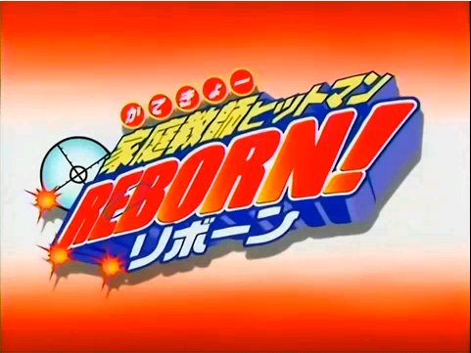
Chrome Dokuro

Slide 2
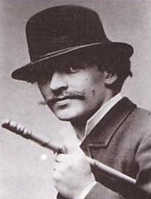
Beginnings of Anime
Anime actually originated from the West, and Émile Cohl is thought of as “The Father of Animated Cartoon”. Western
animation is to be explored in
depth later, but for now, know
the guy on the left and the guys
below.
Shimokawa Oten
Kouchi Jun'ichi
Kitayama Seitaro

Slide 3
The earliest known anime (discovered in 2005)
was produced circa 1907 and consists of fifty
frames drawn directly onto a strip of celluloid.
The untitled short depicts a young boy
writing the Chinese characters for
"moving picture"(映画), then turning towards
the viewer, removing his hat, and offering a
salute. The creator's identity is unknown.

Slide 4
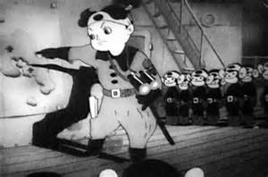
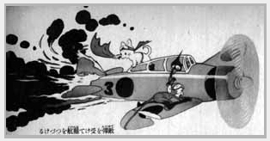
Not very many early animated films survived through
the years, although records show that in the very early
1900s, a movie called Tekugukan was showed in
Kabukiza (a Cinema Centre in Tokyo).
Before and during the world wars,
animation was ‘living’ in Japan only
by commissons, and could not be funded
like it is today. Animation at the time was
being experimented with by coping the
Basics of Disney works. At some point
during the war, some animators were hired
to draw combat scenarios and training
guides for the Japanese miltary.

Slide 5
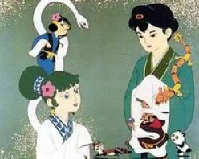
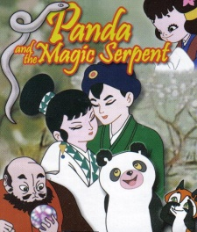
But, after the wars ended, animation grew to become more popular.
Toei Animation was founded and produced the first color anime feature
film, Hakujaden (The Tale of the White Serpent, 1958). This film was
more Disney in tone than modern anime with musical numbers and
animal sidekicks.
It was released in the US as Panda and the Magic Serpent.
Throughout the 1960s and into the early 1970s Toei continued to
release these Disney-like films.

Slide 6
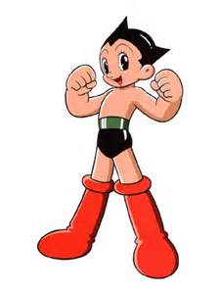
Osamu Tezuka started a rival production company called Mushi
Productions. The studio's first hit Mighty Atom became the first popular
anime television series in 1963. Contrary to popular belief, Atom was
not the first anime series broadcast in Japan; that honor falls to
Manga Calendar, which began broadcasting in 1962. However, Atom was
the first series to feature regular characters in an ongoing plot.
It was rewrote and adapted Atom for the United States in 1964,
retitled as Astro Boy.
The success of Atom in Japan opened the
doors for many more anime titles to be
created, including Mitsuteru Yokoyama's Tetsujin
28-go (later released in the U.S. as Gigantor),
Tezuka's Jungle Emperor (later released in the U.S.
as Kimba the White Lion) and Tatsuo Yoshida's
Mach Go Go Go (later released in the U.S.
as Speed Racer).

Slide 7
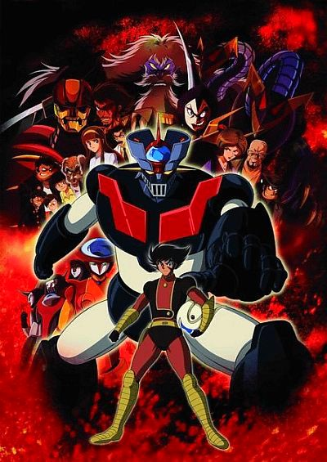
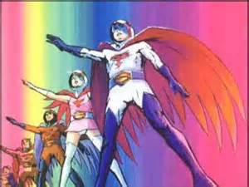
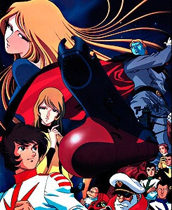
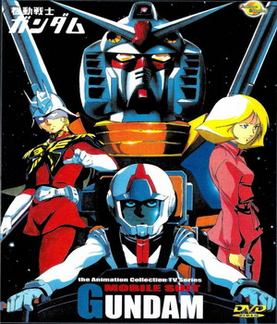
In the early 70s, anime production went down again due to other series
Now airing on television, especially dramas and soap operas.
However, in the late 70s, the mecha genre was born.
Some early works include Mazinger Z (1972-74), Science Ninja Team
Gatchaman (1972-74), Space Battleship Yamato (1974-75) and Mobile
Suit Gundam (1979-80). SciFi genres also became more prominent
as well as the theme of “good vs bad”, and the iconic ‘super hero’.

Slide 8
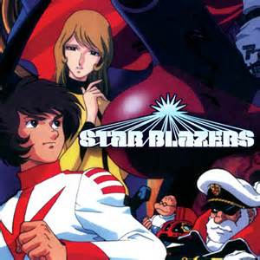
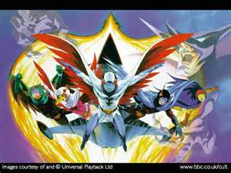
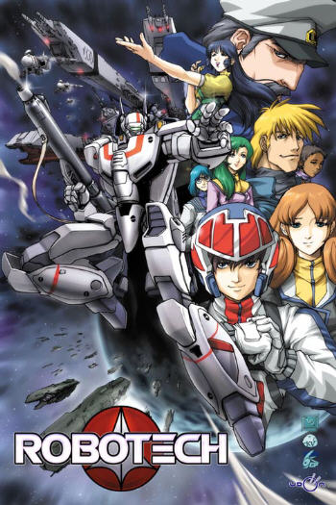
The “Golden Age” of anime came right around the 80s and early 90s.
The theatrical version of Space Battleship Yamato kick-started the
Golden age in the very early 1980s. It was reworked into Starblazers (1979).
Gatchaman was reworked and edited into Battle of the Planets in
1978 and again as G-Force in 1986. Robotech (1985) was created from
three anime titles, The Super Dimension Fortress Macross, Super
Dimension Cavalry Southern Cross and Genesis Climber Mospeada.

Slide 9
Here’s some of the more popular and great works of the 80s Golden Age
DBZ (1989-1996)
Mobile Suit Gundam (1979-1980)
Mobile Suit Gundam (1985)
Tokyo Bubblegum Crisis (1987)
Ranma ½ (1989)
Patlabor: The Mobile Police (1989)
Captain Harlock and the Queen of a Thousand Years
Transformers: The Headmasters

